Slide 1

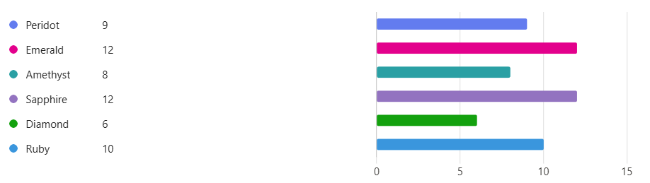
Class Changes – Parental Meeting
Thursday 25th September 2025
A heartfelt thank you to everyone who took the time to complete the recent survey.
Your comments and insights have been incredibly valuable in helping us reflect on current practices.
We are committed to using your feedback to inform positive changes and strengthen our school community moving forward.

Slide 2
Communication
Improving Communication with Parents
It has been acknowledged that communication around recent changes did not meet the standards we strive for.
We fully recognise the impact of this, especially for families who joined our school community in September and were not included in the July mailing. This was a significant oversight, and we sincerely apologise.
In response, parental communication and engagement has now been added as a key priority in our School Development Plan.
We are committed to:
  Sharing information earlier where possible.
  Ensuring all families are included in future communications.
  Creating opportunities for parental feedback and dialogue.

Slide 3
Consultation and Decisions
A Few Key Facts About Our School Structure
Published Admission Number (PAN): John Wilkinson’s PAN is 28. This is the number of pupils we would typically expect in each year group.
Local Demographics: The number of children in our area has declined compared to previous years, which is having an impact on class sizes.
Funding Implications: School funding is directly linked to pupil numbers. Smaller class sizes mean reduced funding, which can lead to difficult decisions about staffing and resources.
Current Position: Based on our current pupil numbers, the school could operate with five classes plus nursery from a financial standpoint.
Our Commitment to Pupils: Despite the financial pressures, we have chosen to maintain a six-class structure. This decision reflects our commitment to meeting the needs of all pupils and providing the best possible learning environment for our school community.

Slide 4
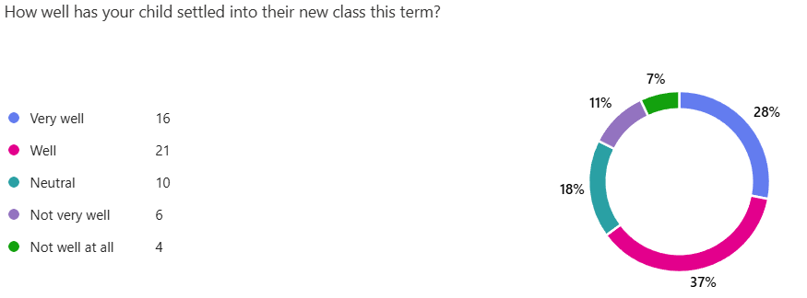
Snap Shot of Results from Survey
Please make an appointment to see your child’s teacher if you feel that they are not settling, so that we can plan for additional support.

Slide 5
Consultation and Decisions
Current Year Group Numbers
Reception: 11
Year 1: 17
Year 2: 15
Year 3: 27
Year 4: 23
Year 5: 18
Year 6: 28
Financial Model – 5 classes
Reception/Y1: 11 +17
Year 2/3: 15 + 12
Year 3/4: 15 + 13
Year 4/5: 10 + 18
Year 6: 28

Slide 6
Mixed-Age Planning
Why Mixed-Age Classes?
Mixed-age classes bring together children from two or more year groups in the same classroom. This approach is increasingly used in schools across the UK and internationally, especially where pupil numbers fluctuate or where schools aim to personalise learning more effectively.
Educational Benefits
Peer Learning: Younger pupils benefit from observing and learning alongside older peers, while older pupils reinforce their understanding by mentoring others.
Flexible Grouping: Teachers can group children by ability, interest, or learning style rather than age alone, allowing for more targeted support and challenge.
Curriculum Spiralling: Pupils revisit key concepts over time, which strengthens retention and deepens understanding.
Social Development: Mixed-age settings foster empathy, leadership, and collaboration.

Slide 7
Mixed-Age Planning
Evidence-Based Research
The Education Endowment Foundation (EEF) has explored mixed attainment grouping and found that:
Implementation requires thoughtful planning and professional development.
While impact on outcomes was not conclusively measured in pilot studies, the approach aligns with inclusive education principles.
Our Commitment
We are committed to:
Ensuring high-quality teaching and learning for all pupils.
Providing staff with the training and support needed to deliver mixed-age teaching effectively.
Listening to parent and pupil feedback and adapting our approach where needed.

Slide 8
Consultation and Decisions
Current Model
Peridots Reception/Y1: 11 + 8
Emerald Year 1/2: 9 + 15
Amethyst Year 3/4: 14 + 9
Sapphire Year 3/4 : 12 + 14
Diamond Year 5/6: 9 + 13
Ruby Year 5/6: 9 + 15

Slide 9
Consultation and Decisions
More questions raised about this arrangement.
Current Model
Peridots Reception/Y1: 11 + 8
Emerald Year 1/2: 9 + 15
Amethyst Year 3/4: 14 + 9
Sapphire Year 3/4 : 12 + 14
Diamond Year 5/6: 9 + 13
Ruby Year 5/6: 9 + 15
Possible option to keep the Y1 cohort together. Will arrange further consultation with parents.
Peridots Reception/Y1: 11 + 17
Emerald Year 2: 15

Slide 10
Consultation and Decisions
Current Model
Peridots Reception/Y1: 11 + 8
Emerald Year 1/2: 9 + 15
Amethyst Year 3/4: 14 + 9
Sapphire Year 3/4 : 12 + 14
Diamond Year 5/6: 9 + 13
Ruby Year 5/6: 9 + 15
General feeling across Key Stage 2 is positive, and we are happy to offer a further consultation survey after the Autumn term parents’ meetings.

Slide 11
Curriculum Organisation
Foundation Subjects & Science Curriculum
Since September 2023, children have been taught in John Wilkinson Primary School using a two-year rolling programme of topics. We are now in the second cycle of Cycle A.
Over the summer, we overhauled and clarified the curriculum offer. While the structure remains consistent, no child will repeat previously taught content.
This rolling programme provides several benefits:
  Consolidation of learning across year groups.
  Moderation opportunities between classes to ensure consistency and quality.
  Joint educational trips, which help reduce transport costs for families and enhance shared learning experiences.

Slide 12
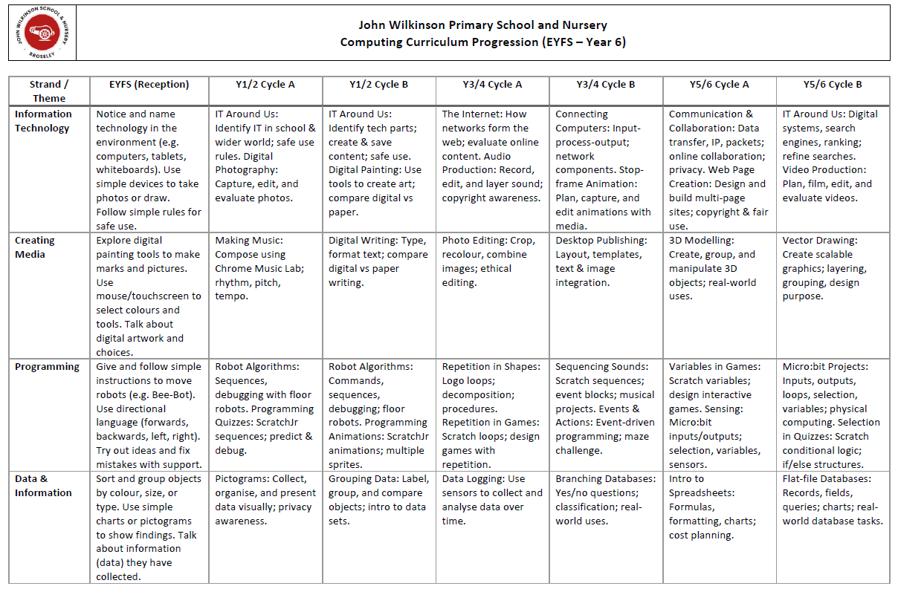
Curriculum Organisation

Slide 13
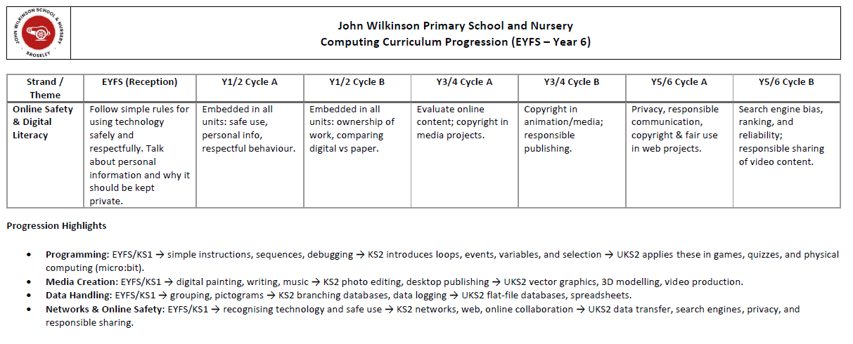
Curriculum Organisation

Slide 14
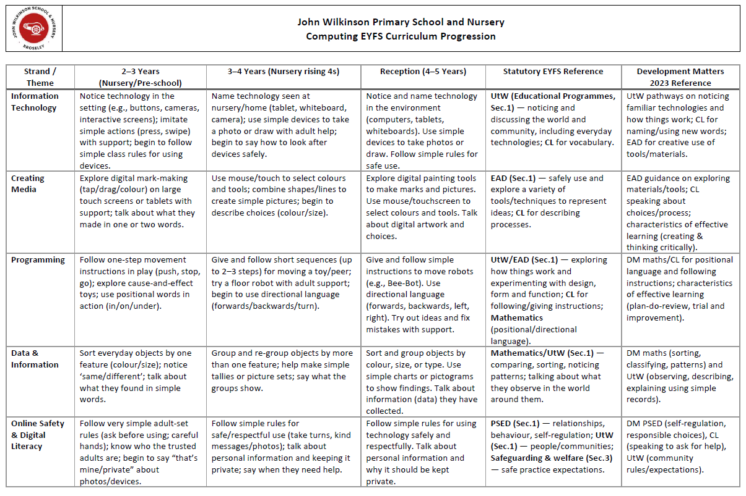
Curriculum Organisation

Slide 15
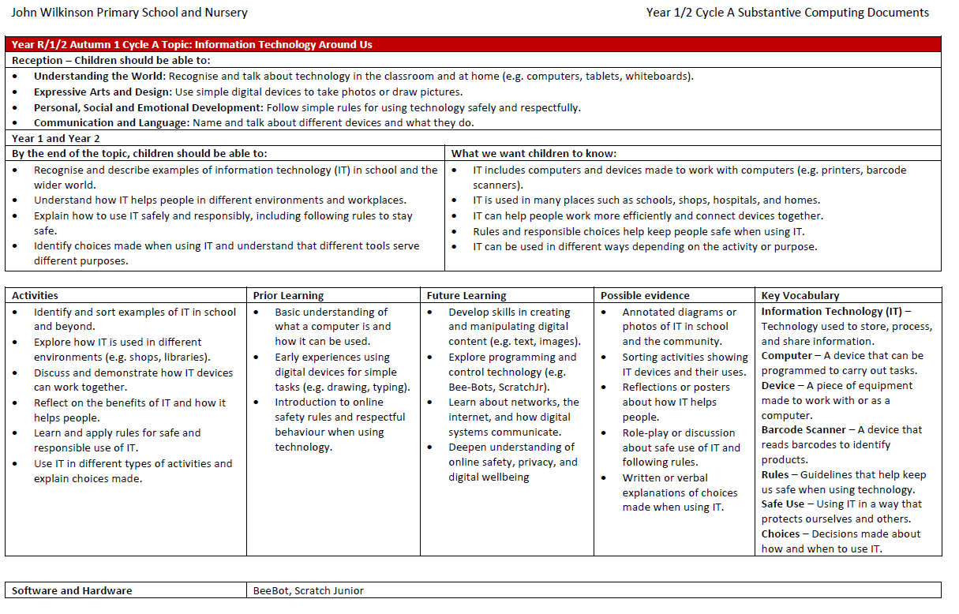
Curriculum Organisation

Slide 16
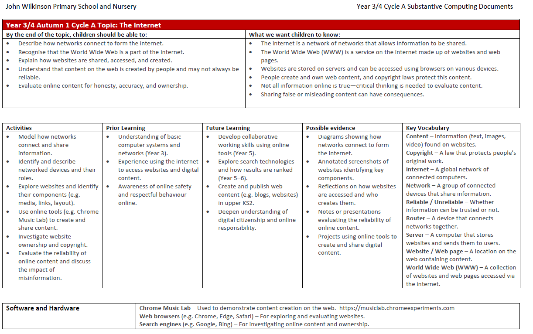
Curriculum Organisation

Slide 17
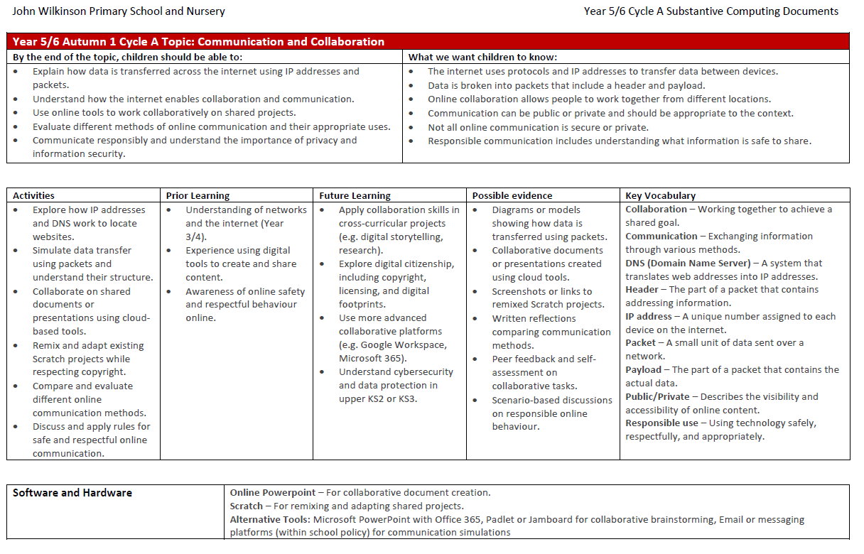
Curriculum Organisation

Slide 18
Curriculum Organisation
English & Phonics Provision
English is taught in mixed-age classes, supported by our investment in Pathways for Writing. This programme provides a clear, structured approach to developing key skills and knowledge.
While all children work around the same core texts, the assessment criteria are tailored to each year group, ensuring progression and appropriate challenge.
We continue to allocate significant staffing to the delivery of phonics, allowing us to create targeted groups based on individual learning needs—not year group.
This flexible model means children may move between groups, but it has been in place for several years and consistently delivers strong outcomes.

Slide 19
Curriculum Organisation
Maths Provision Across the School
In Key Stage 2, children are taught in single-age classes for both Maths and Guided Reading, allowing for focused teaching aligned with year group expectations.
In Reception and Key Stage 1, children remain in their class groups, with work carefully differentiated to ensure appropriate objectives and outcomes for each child.
We are currently taking advice from an external consultant to further strengthen this approach and ensure best practice.
As part of this development, we are exploring a scheme called Number Sense, designed to support mathematical fluency.
More information will be shared with parents soon.

Slide 20
Curriculum Organisation
PE & Enrichment Clubs Update
We have continued to invest in the sports provision offered through TrustEd.
Unfortunately, we were informed very late last term that TrustEd could no longer provide PE coaching or after-school sports clubs this year due to capacity issues.
This decision was outside of our control and communicated with very short notice.
We are pleased to share that Miss Slarke is delivering curriculum PE during PPA afternoons and is working closely with TrustEd on a training programme to maintain the high standards we expect.
This change has temporarily impacted our ability to offer the range of after-school clubs previously available.
We are actively exploring external providers to offer additional enrichment clubs, ensuring all necessary safeguarding checks and quality assurances are in place.

Slide 21
Curriculum Organisation
PE & Enrichment Clubs Update (Continued)
Swimming provision will continue for Years 5 and 6, ensuring pupils have access to this important part of the PE curriculum.
We are still accessing a range of competitions and activity days, and remain committed to offering enriching experiences wherever possible.
Our Year 6 pupils are continuing their training as Bronze Ambassadors, and we are delighted that this valuable partnership is ongoing.

Slide 22
Curriculum Organisation
We are aiming to have the newly adapted curriculum offer live on the website by October half term.

Slide 23
Arbor App
Arbor Behaviour Communication Update
  The 318 Trust is changing how Arbor is used for behaviour across its primary schools.
  While these changes are being agreed, the parent app will not be used to communicate behaviour information.
  I recognise that many parents valued this feature for staying informed.
  I will revisit this with the Trust, as there is potential to use the app for sharing updates quickly and effectively.
  I hope to provide a further update by the Autumn parent’s evening.

Slide 24
Behaviour and SEND
ELSA & Emotional Support
Mrs Bigwood is now a trained ELSA (Emotional Literacy Support Assistant) and is working with children across the school.
We have set up ‘The Treasure Chest’ (in the old Year 4 classroom) to offer further emotional support.
Used for:
    ELSA sessions
    Cool Kids interventions
    Time out and quiet space
The nurture group continues three days a week, now also based in ‘The Treasure Chest’.

Slide 25
Behaviour and SEND
SENDCO Update
Mrs Boam is now our SENDCO.
Mrs Fleming continues to offer invaluable advice, drawing on her years of experience in the role.
We are working closely with Sadie Howson from the 318 Trust to ensure our SEND provision meets all children’s needs.
We are addressing any anomalies and making necessary improvements at pace.
We will continue to work closely with families - please contact us if you have any concerns about potential SEND.

Slide 26
Behaviour
Relational Behaviour Policy
In line with the 318 Trust’s Relational Behaviour Policy, staff are working with Educational Psychologist Dan Cumber to develop the PACE approach.
This work is being extended to include emotion coaching - further information will be shared soon.
We recognise that some children have found the transition back to school after summer challenging.
We are committed to supporting all children and will continue to provide additional help where needed.

Slide 27
Any Questions or Comments
?

Slide 28
Thank you for coming.

